Slide 1

Natural Language Processing
Recitation Class

Slide 2
What is Glove?
GloVe, which stands for Global Vectors for Word Representation, is a popular technique in Natural Language Processing (NLP) for word embedding.
It's designed to capture the global statistics of word co-occurrence.
How Does GloVe Work?
GloVe calculates word embeddings by considering the co-occurrence statistics of words in a large text corpus.
The key insight is that the ratio of co-occurrence probabilities for pairs of words is meaningful.

Slide 3
Co-Occurrence Matrix
Rows represent target words.
Columns represent context words.
Cells contain the number of times a target word and a context word co-occur within a specified context window.

Slide 4
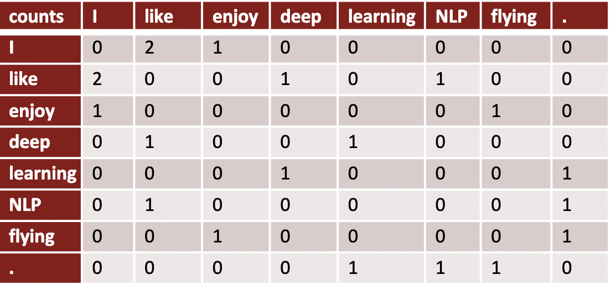
Example of Co-Occurrence matrix
Example corpus: • I like deep learning • I like NLP • I enjoy flying

Slide 5
Advantage of Glove
Captures global word co-occurrence patterns.
Produces meaningful word embeddings.
Useful for various NLP tasks.

Slide 6
Application of Glove
Text Classification: Categorizing text into predefined classes or labels.
Example: Classifying emails as either "spam" or "not spam."
Sentiment Analysis: Determining the sentiment or emotional tone of a piece of text.
Example: Analyzing social media comments to determine if they are "positive," "negative," or "neutral."
Recommender Systems: Suggesting relevant items or content to users based on their preferences and behavior.
Example: Recommending movies to users on a streaming platform based on their past viewing history.
Machine Translation: Automatically translating text from one language to another.
Example: Translating an English sentence, "Hello, how are you?" into French as "Bonjour, comment ça va ?"
Named Entity Recognition (NER): Identifying and classifying named entities (e.g., names of people, places, organizations) in text.
Example: Extracting "Apple Inc." as an organization from the sentence "Apple Inc. is headquartered in Cupertino, California."

Slide 7
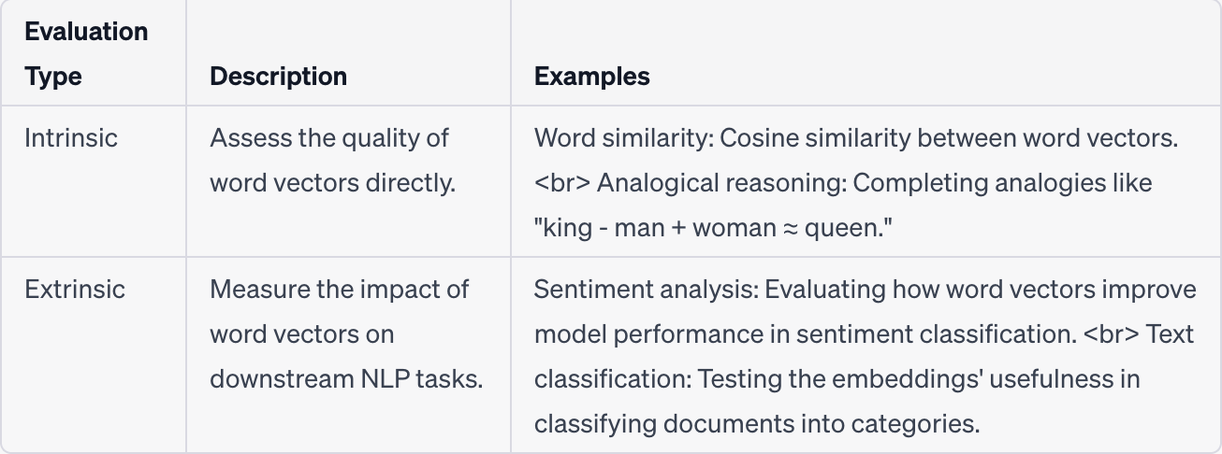
Evaluation of word vectors:

Slide 8
Neural Classification in NLP?
Neural classification in Natural Language Processing (NLP) refers to the use of neural networks to perform classification tasks on text data.
This technique leverages deep learning models to automatically learn and extract features from textual data and make predictions or categorize text into predefined classes or labels.
Neural classification has become a dominant approach in NLP due to its effectiveness in handling various text-based tasks.

Slide 9
Explanation of Neural Network step by step
Step 1: Neuron (Perceptron)
A neural network is built upon the fundamental building block called a "neuron" or "perceptron." It takes multiple inputs, performs a weighted sum of these inputs, adds a bias term, and applies an activation function to produce an output.
Inputs (x1, x2, ..., xn): Numerical values or features.
Weights (w1, w2, ..., wn): Each input is multiplied by a weight.
Bias (b): A constant term added to the weighted sum.
Activation Function (f): Typically, a non-linear function like sigmoid or ReLU.

Slide 10
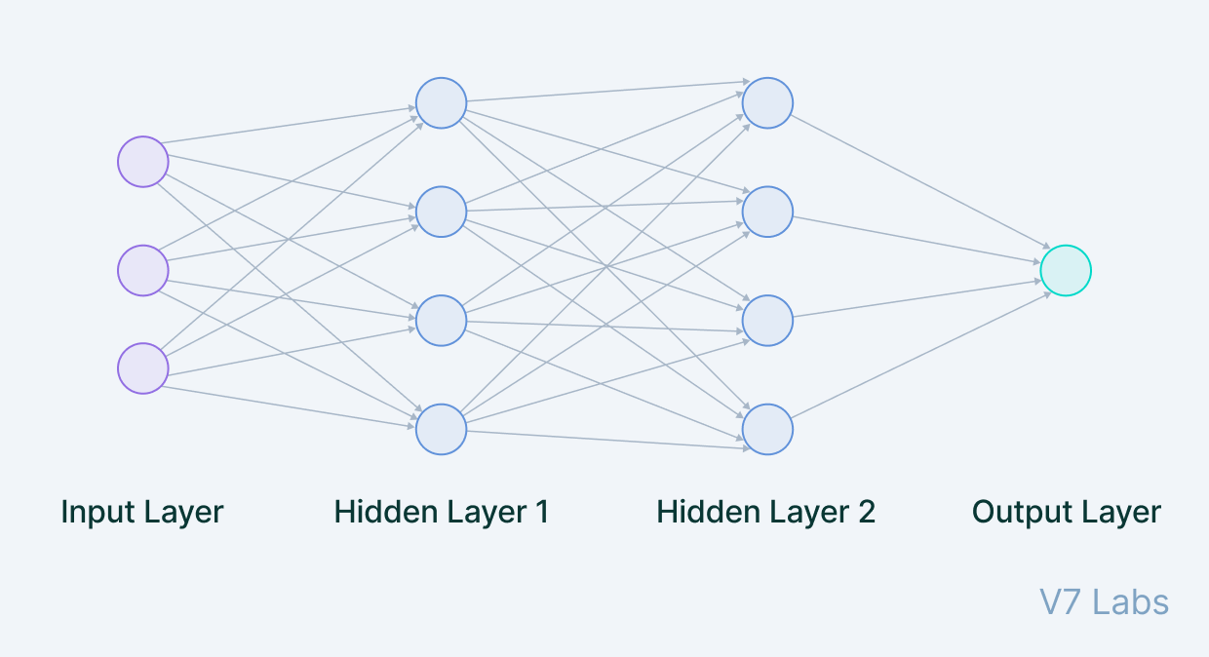
Step 2: Neural Network Architecture
Neural networks consist of layers of interconnected neurons. There are typically three types of layers:
Input Layer: This layer accepts the initial input data and passes it to the next layer.
Hidden Layers: These layers are in between the input and output layers. They perform various transformations on the data.
Output Layer: This layer produces the final output of the network.

Slide 11
Step 3: Feedforward
The feedforward process is the flow of data from the input layer through the hidden layers to the output layer. Neurons in each layer receive inputs from the previous layer, process them as described in Step 1, and pass the results to the next layer.
Step 4: Weights and Bias
The connections between neurons have associated weights and a bias term. These values are learned during training to make the network produce the desired output for a given input.

Slide 12
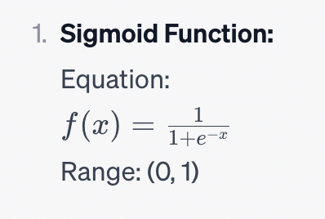
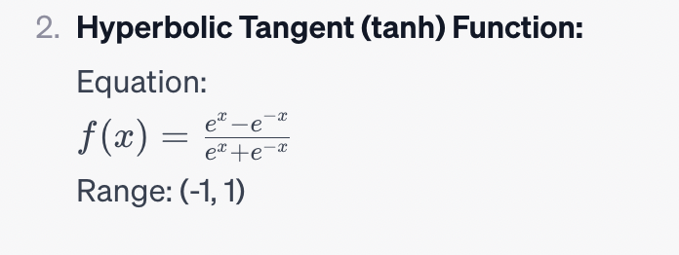
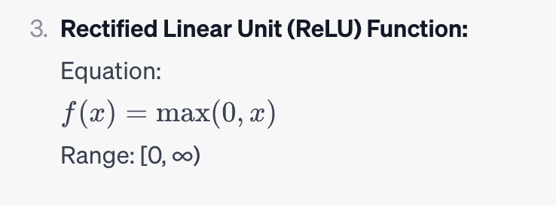
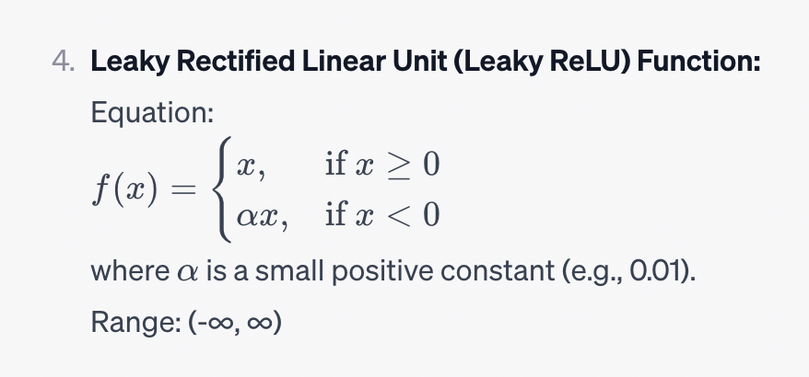
Step 5: Activation Functions
Activation functions introduce non-linearity into the network. Common activation functions include sigmoid, ReLU (Rectified Linear Unit), and tanh. They allow neural networks to model complex relationships in the data.

Slide 13
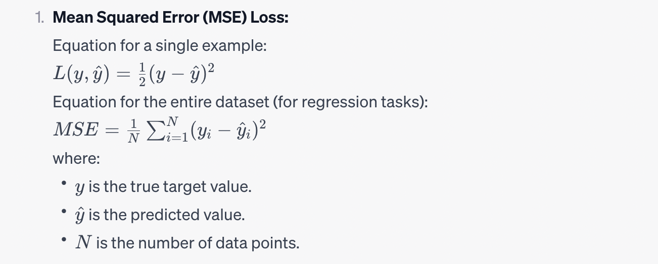
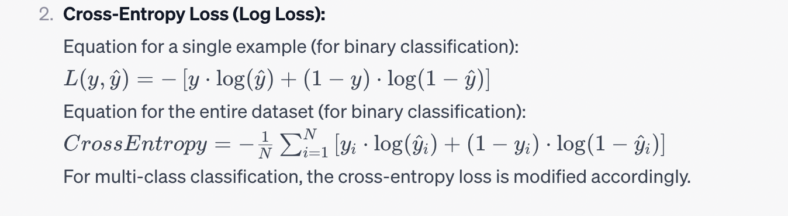
Step 6: Loss Function
A loss function measures the difference between the predicted output and the true target values. The goal during training is to minimize this loss. Common loss functions include mean squared error (MSE) for regression tasks and cross-entropy for classification tasks.

Slide 14
Step 7: Backpropagation
Backpropagation is the process of updating the weights and biases in the network to minimize the loss. It works by calculating the gradients of the loss with respect to the weights and biases and adjusting them in the opposite direction of the gradient.
Step 8: Training
The training process involves repeatedly feeding data through the network, calculating the loss, and using backpropagation to update the parameters (weights and biases) until the model performs well on the training data.
Step 9: Inference
Once the neural network is trained, it can be used for inference. New data is fed into the trained network, and it produces predictions or classifications.

Slide 15
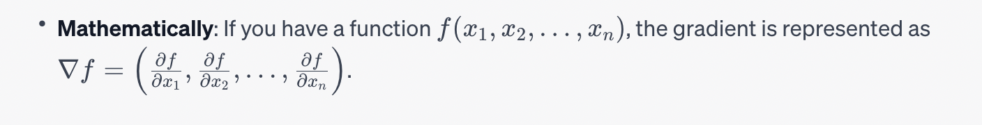
Gradient:
In the context of machine learning and optimization, it's often used to find the minimum (or maximum) of a function by iteratively updating a parameter vector in the opposite direction of the gradient.

Slide 16
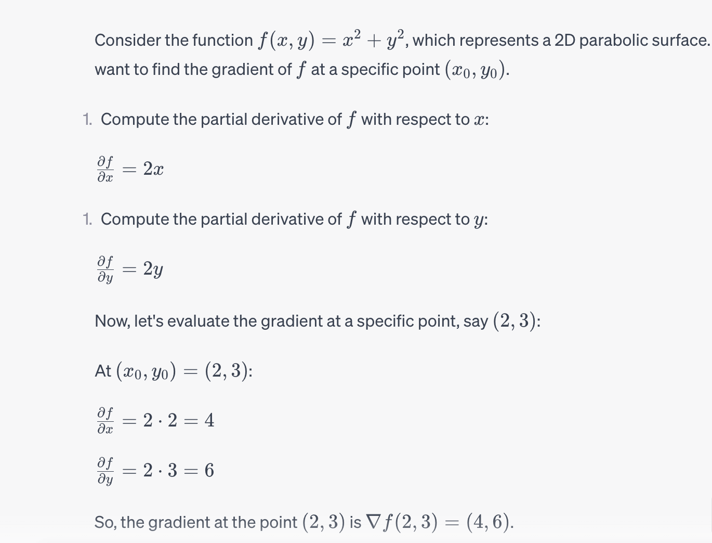

Slide 17
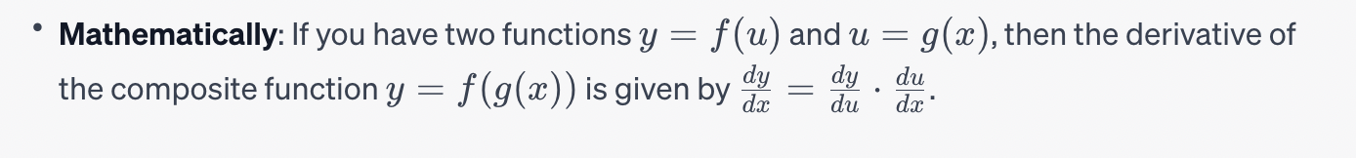
Chain Rule
The chain rule is a fundamental concept in calculus that allows you to find the derivative of a composite function. It states that the derivative of the composition of two functions is the product of the derivative of the outer function and the derivative of the inner function.

Slide 18
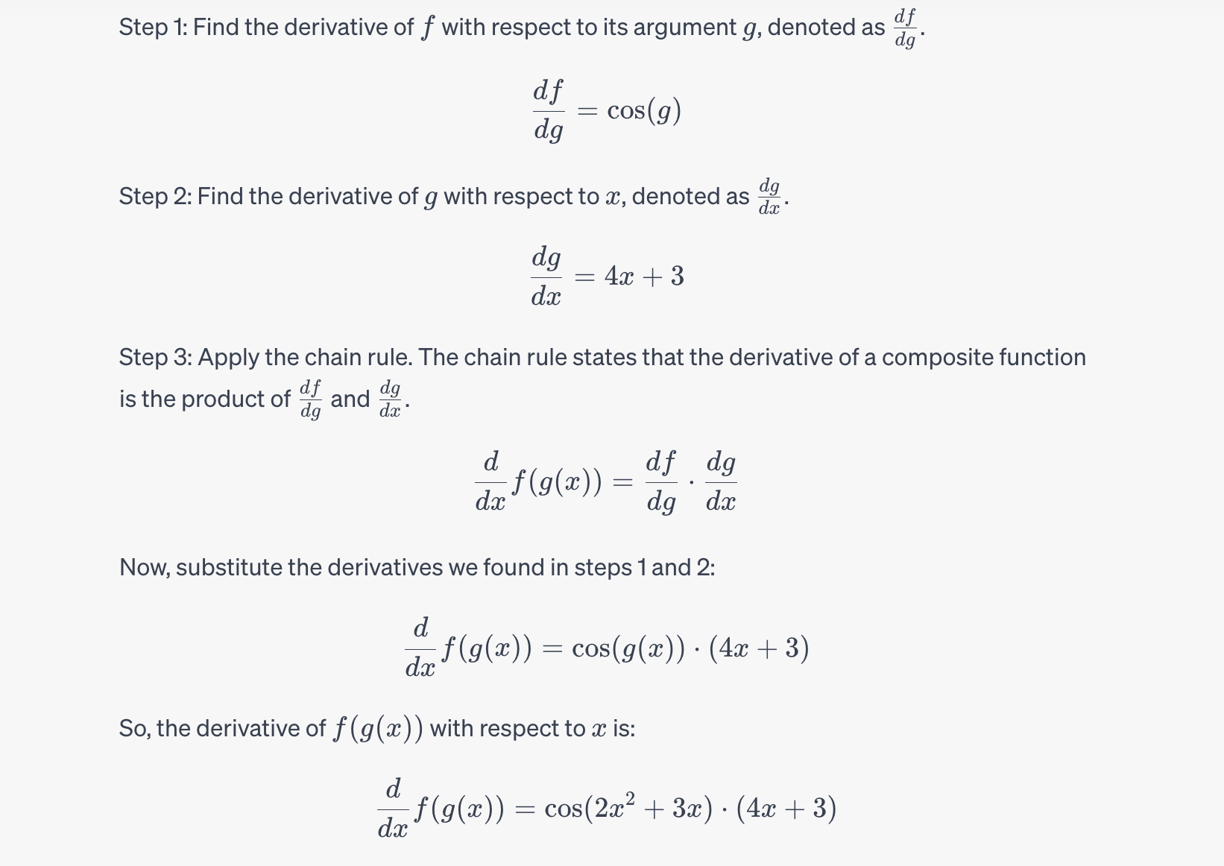
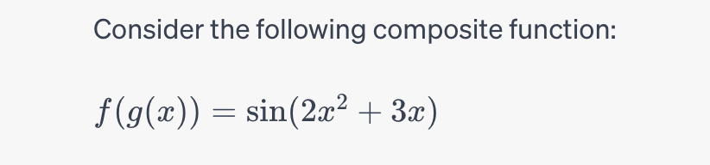

Slide 19
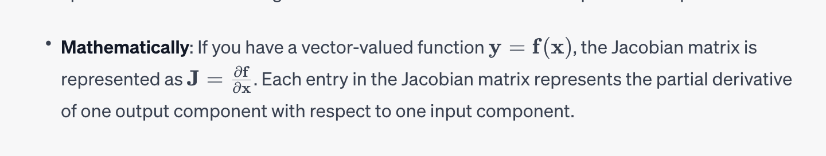
Jacobians
The Jacobian matrix is a generalization of the gradient for vector-valued functions. It represents the rate of change of a vector-valued function with respect to its input variables.

Slide 20
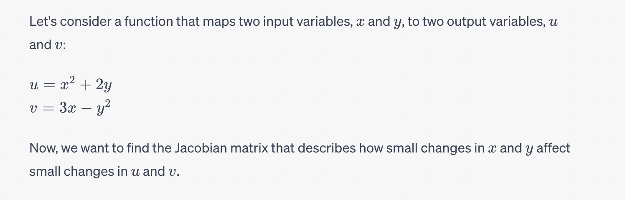
Example of Jacobians

Slide 21
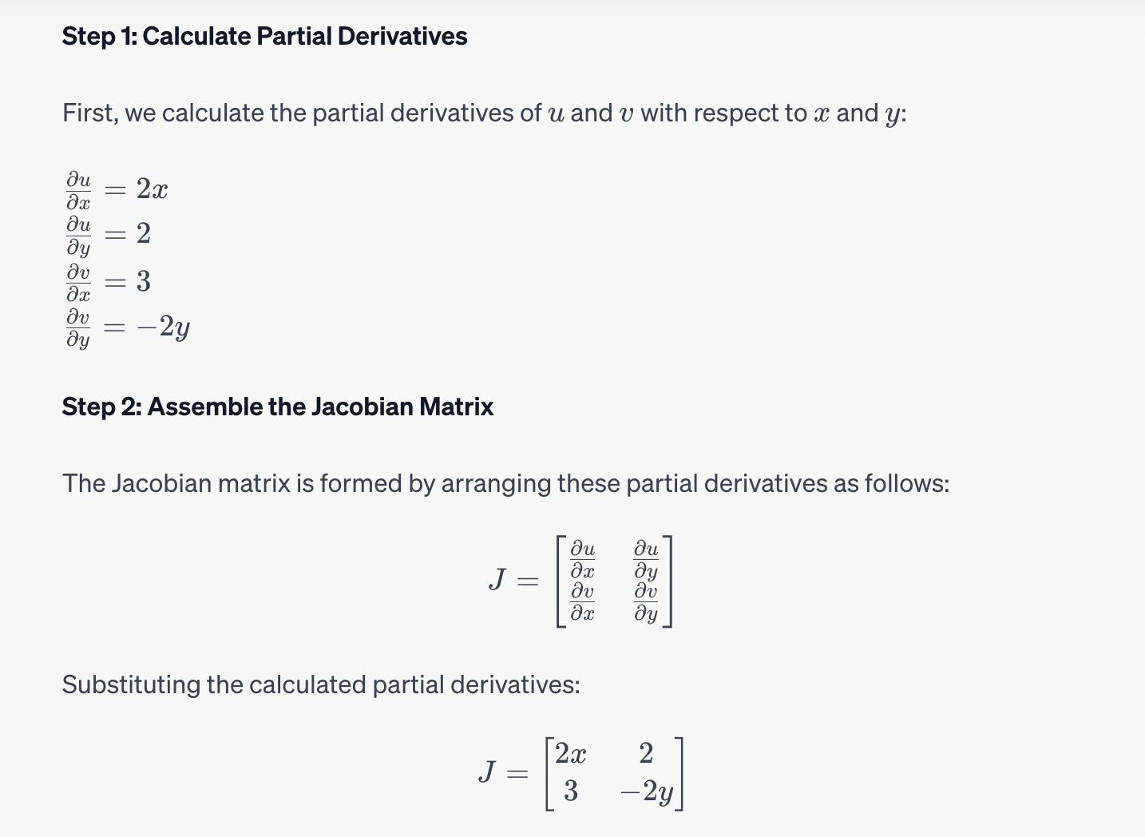

Slide 22

Thank you.

